Slide 1
UNIT – 1 INTRODUCTION
Programming in C (COM412)
BSc CSIT First Semester
Mid-West University
Birendranagar, Surkhet, Nepal
Prepared by:
Dabbal Singh Mahara
Asst. Prof.
2023

Slide 2
TOPICS COVERED
PROGRAMMING LANAGUAGES
PROBLEM SOLVING WITH COMPUTER
ALGORITHMS
FLOWCHARTS

Slide 3
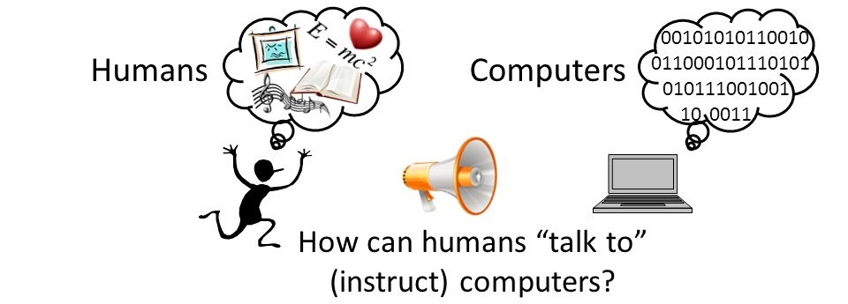
Programming Languages
Answer: with the help of computer programs

Slide 4
Programming Languages
A programming language is an artificial language which is used to develop programs in computer.
It is a set of rules that provides a way of instructing the computer to perform certain operations.
A program is a set of instructions written in a specific programming language that a computer can interpret and execute.

Slide 5
Programming Languages
The programming languages are mainly divided into two types. They are :
Low Level Language
Machine Language
Assembly Language and
High Level Language

Slide 6
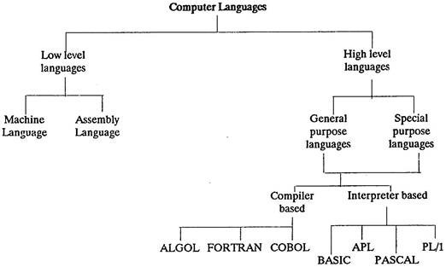

Slide 7
Low Level Languages
Low level languages are the programming languages which are closer to the machine architecture.
Thus, low level languages are better understood by the computer.
Low level languages are further divided into two categories:
Machine Languages
Assembly Languages

Slide 8
Machine Level Languages
The machine-level language is a language that consists of a set of instructions that are in the binary form 0 or 1.
It is directly understood by the computer. It requires no translator to translate the code.
Machine language is the lowest form of computer language.
When first generation computers were introduced, programs were written only in binary based machine level language.
Machine language makes fast and efficient use of the computer.

Slide 9
Disadvantages of Machine Languages
It is difficult to understand and develop a program using machine language.
It is a machine-oriented language. The knowledge of computer internal architectures is essential for program coding.
Time consuming for coding.
Debugging is tough and difficult.

Slide 10
Assembly Languages
Assembly language is also known as Symbolic language. It uses mnemonics or abbreviated words as instruction.
Like machine language, it also being oriented towards the basic design of computers, So it is also called low level language.
Considering the difficulties encountered with the machine language, the assembly languages were developed in 1950’s and were introduced in the second generation computers.
Some mnemonics are given below:
ADD for Addition, SUB for Subtraction,
LDA for load Accumulator, STA for store Accumulator

Slide 11
Assembly Languages
Advantages:
Coding is faster than machine code language because mnemonics are used for program coding.
Less time consumed respect to Machine code languages.
Debugging is easy.
Disadvantages
Machine oriented language
The good knowledge of machine architectures is required.
Time consuming for programming and debugging
Translator is used to translate program into machine code.
Not as fast as machine code language in case of execution

Slide 12
High Level Languages
The time and cost of creating machine and assembly languages were quite high and this is the first motivation for development of high-level computer language.
High level language contains a set of instructions written in simple English. It is a set of some symbols, words and rules to instruct machine.
The language is oriented towards the problem and procedures.
Program written in high level language is called source program.
A language translator is used to translate into object code (Machine code).

Slide 13
High Level Languages
Advantages:
Simple English is used for program coding.
Machine independent
Problem and procedure oriented.
The knowledge of computer architectures is not necessary. It requires less time for program coding.
Program can be debugged easily and program maintenance is also easy.
Limitations:
It takes additional translation times to translate the source to machine code.
High level programs are comparatively slower than low level programs.
Compared to low level programs, they are generally less memory efficient.
Cannot communicate directly with the hardware.

Slide 14
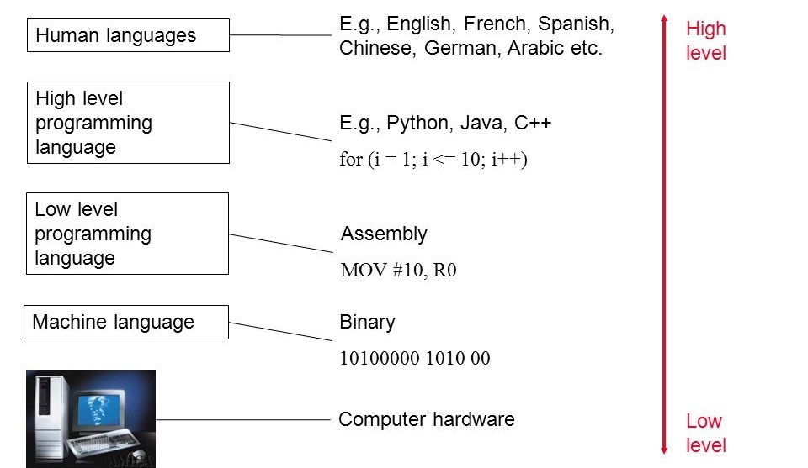
High Level and Low Leve Languages

Slide 15
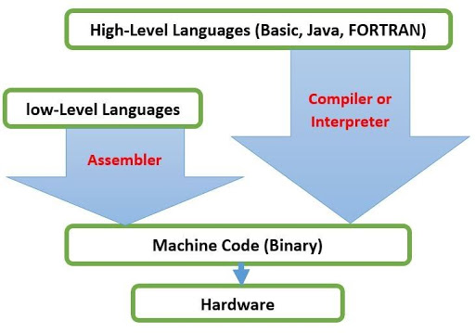
Language Translators
Assembly Language

Slide 16
What is a Compiler?
A compiler is a program that can read a program in one language- source language, and translate it into an equivalent program in another language – target language.
An important role of the compiler is to report any errors in the source program that it detects during the translation process.

Slide 17
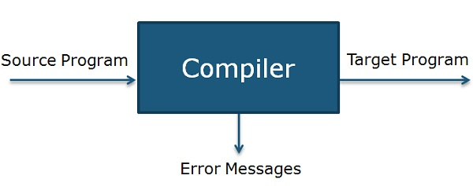

If the target program is an executable machine program, it can then be called by user to process inputs and produce outputs.

Slide 18
Interpreter
Instead of producing a target program as a translation, an interpreter appears to directly execute operations specified in the source program on inputs supplied by the user.
An interpreter, however, can give better error diagnostics than a compiler because it executes instructions one by one.
source program
Interpreter
output
Input

Slide 19
Compiler Vs Interpreter
Title | Compiler | Interpreter
Input | Compiler takes Entire program as input at a time. | Interpreter takes Single instruction as input at a time.
Output | Intermediate Object code is generated | No Intermediate Object code is generated
Memory | More memory is required. Due to the creation of object code. | Less memory is required. It does not create intermediate object code.
Need Compile | Program need not to be compiled every time | Every time higher level program is converted into lower level program
Error | It display error after entire program is checked | It display error after each instruction interpreted (if any)
Error Detection | Difficult | Easier Comparatively
Pertaining Programming languages | C, C++, C#, Scala, typescript uses compiler. | Basic, PHP, Perl, Python, Ruby uses an interpreter.

Slide 20
Assignment #1
Survey the programming languages used in different generations (1st, 2nd , 3rd , 4th and 5th ) of computers.

Slide 21
Problem Solving with Computer
There are a number of problems to be solved using computer.
How to solve these problems?????
Write a program in computer.
But a program must be planned before coding in a programming language so as to make sure that program/instructions are appropriate to solve the problem and are in the correct sequence.

Slide 22
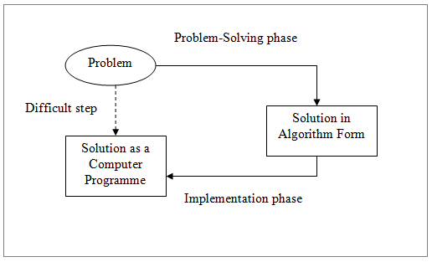
Problem Solving with Computer

Slide 23
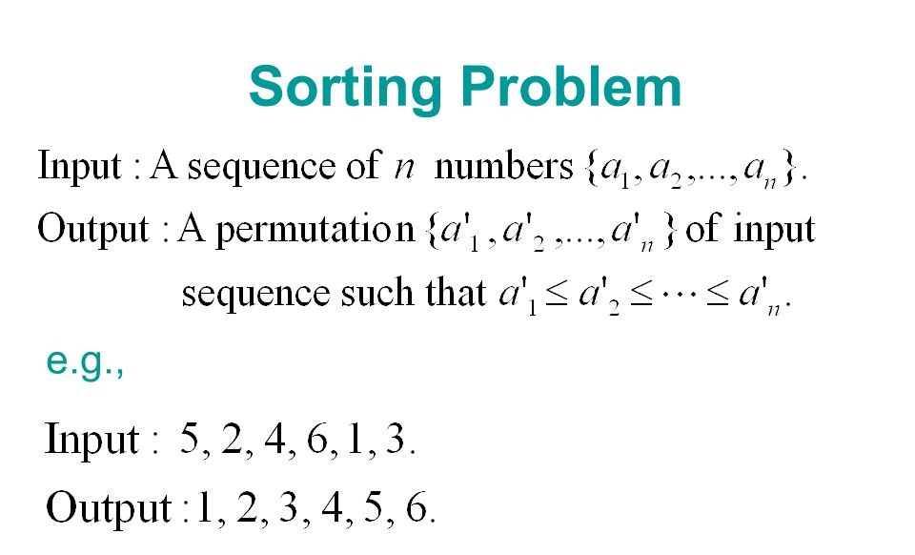

Slide 24
Steps in Solving Problem with Computer
There are a no. of steps while solving a problem using computer. They are:
Problem Analysis
Algorithm Development
Flowcharting
Coding
Compilation & Execution
Debugging & Testing
Documentation

Slide 25
Problem Analysis
This step is the process of becoming familiar (by analyzing and understanding)with the problem that will be solved with a computer program.
The program’s inputs, outputs, different ways of solving problems, its constraints, software and hardware requirements, available time period should be known in advance.
E.g. when we have to prepare banking solution, we must know different activities to be done in a bank, required input forms and output reports.
This is the task of a system analyst.
Note: Inadequate recognition of a problem may cause program less useful and insufficient.

Slide 26
Algorithm Development
The word “algorithm” relates to the name of the mathematician Al-khowarizmi, which means a procedure or a technique.
Software Engineer commonly uses an algorithm for planning and solving the problems. An algorithm is a step-by-step description of the method to solve a problem.
Algorithm maintains sequences of computer instructions required to solve a problem in such a way that if the instructions are executed in the specified sequence, the desired result is obtained.

Slide 27
Example: Algorithm for finding the sum of any two numbers
Algorithm
Step 1: Start
Step 2: Display “Enter two numbers”
Step 3: Read A and B
Step 4: C = A + B
Step 5: Display “C as sum of two numbers”
Step 6: Stop

Slide 28
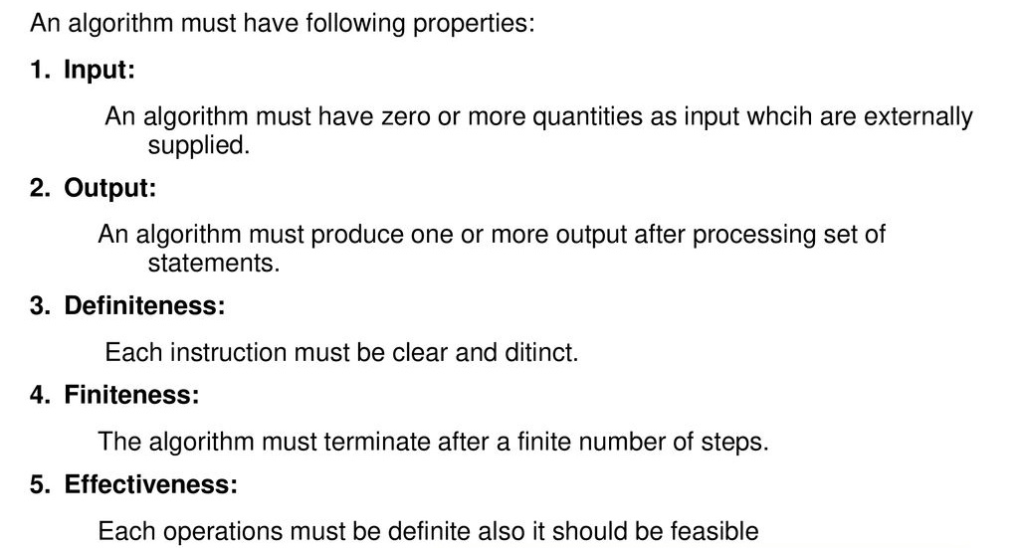
Characteristics of Algorithms

Slide 29
Algorithm Development…
Any algorithm has following 3 features:
Sequence (also known as process)
Decision (also known as selection)
Repetition (also known as iteration)
Sequence
Sequence means that each step or process in the algorithm is executed in the specified order…
A previous step must be executed before any other next steps.

Slide 30
Algorithm Development…
Decision
If the outcome of the decision is true, then one thing is done otherwise other thing is done.
The outcome of decision is either true or false; there is no state in between them.
This decision is based on some condition.
E.g. If a number is less than 0, then the no. is negative otherwise positive.
The general form of a decision making statement is:
if condition then
process1
Else
process2

Slide 31
Algorithm Development…
Repetition
The repeat loop is used to iterate or repeat a process or sequence of processes until some condition is true.
E.g.
count = 0
Repeat
Print “ Hello There !”
count = count + 1
until count =10

Slide 32
Algorithm Development…
Some Conventions used in Developing Algorithms
Each algorithm is enclosed by two statements START and STOP.
To accept data from user, the INPUT or READ statement is used.
To display any user message, the PRINT or DISPLAY statement is used.
The arithmetic operators (+, -, *, /) are used in expressions.
The relational operators (>, >=, <, <=, ==, !=) are used in conditions.
The logical operators (AND, OR, NOT) are used for logical expressions.

Slide 33
Problem: Write an algorithm for calculating the simple interest using formula SI = (P*T*R)/100.
Algorithm
Step 1: Start
Step 2: Display “Enter values of P, T and R”
Step 3: Read P, T and R
Step 4: Calculate simple interest using formula, SI = (P*T*R)/100
Step 5: Display SI as simple interest
Step 6: Stop.

Slide 34
Problem 3: Write an algorithm to determine whether a number is positive or negative.
Algorithm
Step 1: Start
Step 2: Print “Enter a no. that is to be tested for positive or negative”
Step 3: Read NUM from keyboard
Step 4: If NUM<0, then display message “The number is Negative” otherwise display message “The number is Positive”
Step 5: Stop.

Slide 35
Problem 4: Write an algorithm to test whether a number is even or odd.
Algorithm
Step 1: Start
Step 2: Display “Enter a number that is to be tested for even or odd”
Step 3: Read NUM from user
Step 4: Calculate remainder REM using integer division of NUM by 2
Step 5: If REM = 0, then print “The number is even”
else print “The number is odd”
Step 6: Stop

Slide 36
Problem 5: Write an algorithm to find the largest number among three numbers.
Algorithm
Step 1: Start
Step 2: Display “Enter three numbers”
Step 3: Read A, B and C
Step 4: If A>=B and A>=C, then print “A is greatest”
Step 5: If B>=A and B>=C, then print “B is greatest”
else print “C is greatest”
Step 6: Stop

Slide 37
Problem 6: Write an algorithm to read N numbers from user and display the sum of all entered numbers.
Algorithm
Step 1: Start
Step 2: Print “How many numbers?”
Step 3: Read N
Step 4:Initialize SUM=0 and COUNTER=1
Step 5: Print “Enter a number”
Step 6: Read NUM
Step 7: SUM = SUM+NUM
Step 8: COUNTER = COUNTER + 1
Step 9: If COUNTER <= N, then goto Step 5
Step 10: Print SUM
Step 11: Stop

Slide 38
Problem 7: Write an algorithm for finding the sum of the series 1+2+3+….. upto N terms.
Algorithm
Step 1: Start
Step 2: Print “Enter the value of N”
Step 3: Read N
Step 4:Initialize variables SUM to 0 and COUNTER to 1 i.e. SUM=0 and COUNTER=1
Step 5: SUM = SUM+COUNTER
Step 6: COUNTER = COUNTER + 1
Step 7: If COUNTER <= N, then goto Step 5
Step 8: Print SUM
Step 9: Stop

Slide 39
Problem 8: Write an algorithm for finding the factorial of a given number.
Algorithm
Step 1: Start
Step 2: Print “Enter a number”
Step 3: Read NUM
Step 4:Initialize variables FACT=1 and COUNTER=1
Step 5: while COUNTER<=NUM
FACT=FACT*COUNTER
COUNTER=COUNTER+1
End of while
Step 6: Print FACT as factorial of the number NUM
Step 7: Stop

Slide 40
Flowchart
Flowchart is the graphical representation of an algorithm using standard symbols.
Programmers often use it as a program-planning tool to solve a problem.
It makes use of symbols which are connected among them to indicate the flow of information and processing.

Slide 41
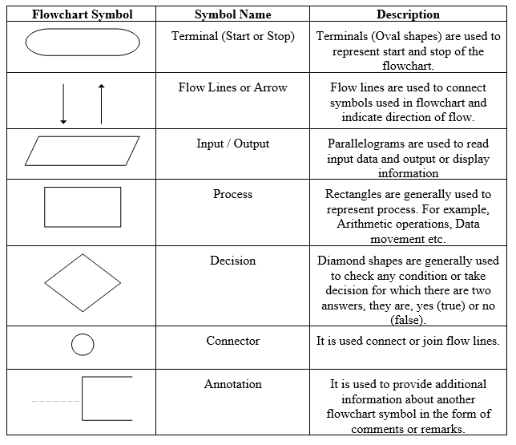
Standard Symbols used in Flowcharts

Slide 42
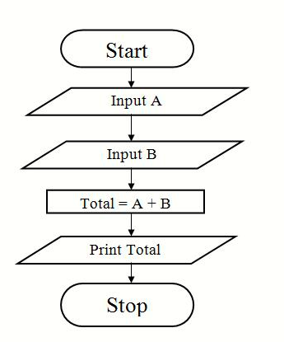
Flow chart to add two numbers.

Slide 43
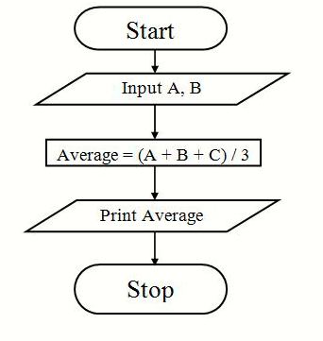
Flowchart to find Average of 3 numbers

Slide 44
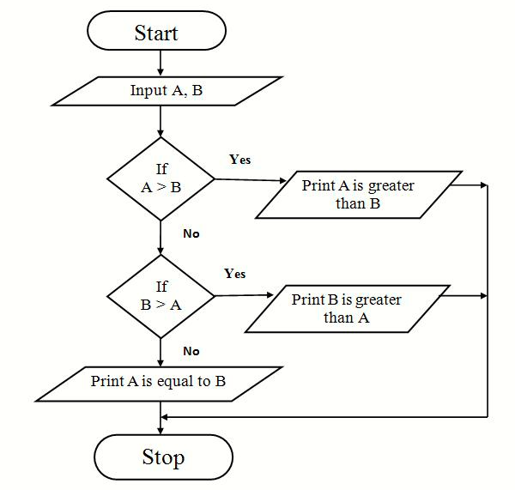
Flow chart to find the larger of two numbers.

Slide 45
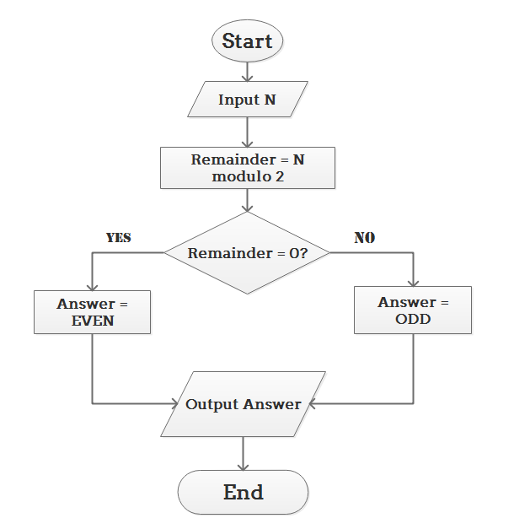
Flowchart to check input number is odd or even.

Slide 46
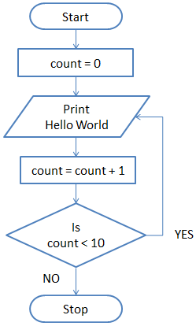
Flowchart to print Hello World 10 times

Slide 47
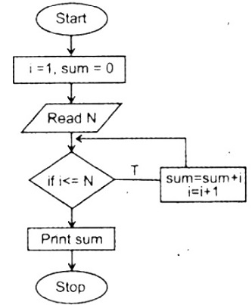
Flow chart of sum of first N natural numbers

Slide 48
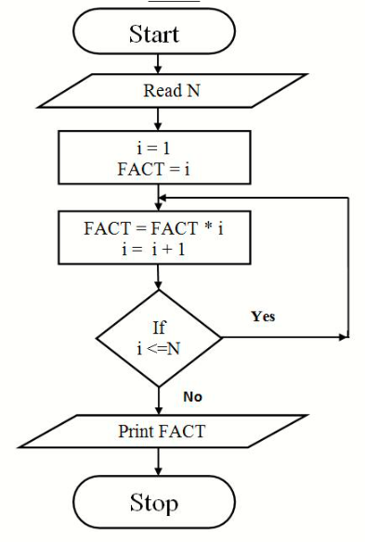
Flow Chart to Find Factorial of a number

Slide 49
Advantages of Flowcharts
Communication: They quickly and clearly provide logic, ideas and descriptions of algorithms to other programmers, students, and users.
Effective Analysis: Flowcharts provide a clear overview of the entire problem and its algorithm for solution. With the help of flowcharts, problems can be analyzed more effectively.
Proper Documentation: The flowchart provides a permanent recording of program logic.
Efficient Coding: A programmer can code the programming instructions in a computer language with more ease with a comprehensive flowchart.
Easy in debugging and program maintenance

Slide 50
Limitations of Flowchart
Complex Logic: A flowchart becomes complex and clumsy when the program logic is quite complicated.
Difficulty in alteration and modifications: If alterations are required; the flowchart may need to be redrawn completely.

Slide 51
Guidelines in Flowcharting
Only standard flowchart symbols are to be used.
There should be Start and Stop to the flowchart.
Only one flow line is used in conjunction with a Start and Stop symbol.
Only one flow line should emerge from a process symbol.
Only one flow line should enter a decision symbol but two flow lines, one for each possible answer, can leave the decision symbol.
The contents of each symbol should be written legibly. English should be used in flowcharts, not specific programming language.
If the flowchart becomes complex, connector symbols should be used to reduce the number of flow lines.

Slide 52
Coding
Coding is the act of transforming operations in each box of the flowchart in terms of the statement of the programming language.
Coding is done using a programming language such as C, C++, Java, Python etc.
The code developed using a programming language is also called source code.
Coding must eliminate all syntax and logical errors.

Slide 53
Compilation and Execution
The process of changing high level language into machine level language is known as compilation. It is done by special software, known as compiler.
The compilation process tests the program whether it contains syntax errors or not. If there are syntax errors, compiler cannot compile the code.
After successful compilation, the program is linked with other object programs needed for execution, and then the program is loaded in the memory for the purpose of execution and finally it is executed.
During execution, the program may ask for user inputs and generates outputs after processing the inputs.

Slide 54
Debugging and Testing
Debugging is the discovery and correction of programming errors.
These errors may appear during compilation or linking or execution of the program. Whenever error appears, debugging is necessary.
Different Debugging tools are simulators, logic analyzers, breakpoints, etc
Testing ensures that program performs the required task correctly.
For testing process, test data are supplied to the program and output is observed. If the output is as expected, the program can be considered error free.

Slide 55
Program Documentation
Program documentation is description of the program and its logic written to support understanding the program.
Documentation of program helps to those who use, maintain and extend the program in future.
Two Types:
Programmer’s Documentation (Technical Documentation)
User Documentation (User Manual)
Programmer’s documentation is prepared for future references to the programmers who maintain, redesign and upgrade the system.
User documentation provides support to the user of the program.

Slide 56
Write algorithms and Flowcharts for the following problems:
Assignment #2
To convert temperature from Celsius to Fahrenheit [ F = (9.0/5.0 x C) + 32 ]
To find Area and Perimeter of Square
To find Area and Perimeter of Circle
To find the smallest of two numbers
To display Even numbers between 1 to 50

Slide 57


